Slide 1
College of Architecture
EDUCATION ABROAD

Slide 2
International Programs and Initiatives
Leslie Feigenbaum
Associate Dean for International Programs and Initiatives
leslief@tamu.edu
979.845.7886
Jolynn Hays
Administrative Associate II
jhays@tamu.edu
979-845-1222

Slide 3
College of Architecture Undergraduate Majors
Construction Science (COSC)
Environmental Architecture (ENDS)
Landscape Architecture (LAND)
Urban Planning (URPN)
Visualization (VIST)
University Studies (USAR)

Slide 4
Each Undergraduate Student in the College of Architecture is required to complete one “semester away”
Education Abroad Programs have been integrated into degree plans and the options vary by degree
https://abroadportal.tamu.edu/index.cfm?FuseAction=Programs.AdvancedSearch&

Slide 5
Types of Abroad Programs
Faculty Led – TAMU faculty travel with the students
Third Party – Third party vendor leads the program typically in conjunction with a “local” University
Partner – TAMU contracts with a partner university
SEC Consortia – Goes on another SEC schools program and is granted in-state tuition rates

Slide 6
Study at Another University
Reciprocal Exchange (REEP) – Exchange places at another university – pay TAMU tuition (contractual relationship between TAMU and another university)
Apply at another university – Likely pay out of state tuition and go through the application process

Slide 7
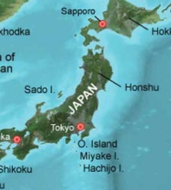
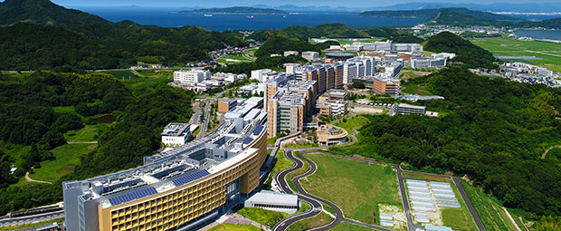
Reciprocal Exchange Programs Locations
Queensland University of Technology
Brisbane, Australia
Kyushu University
Japan

Slide 8
How to Fulfill Semester Away
Program | Internship | Study at Another University | Study Abroad
 |  |  | Fall / Spring | Summer
Construction Science (COSC)
Environmental Design (ENDS)
Landscape Architecture (LAND)
Urban Planning (URPN)
Visualization (VIST)
University Studies (USAR)

Slide 9
CARC Study Abroad Locations
Location | Fall | Spring | Summer
UK – London |  | COSC w/ internship | COSC / USAR
UK - Liverpool |  |  | USAR
UK – Lincoln |  |  | USAR
Germany – Bonn | LAND / URPN/ VIST | VIST | USAR
Spain – Barcelona | ENDS | ENDS | USAR
Italy – Castiglion Fiorentino | ENDS | ENDS
Italy – Florence | VIST | VIST | USAR
Japan |  |  | USAR
Peru |  |  | USAR

Slide 10
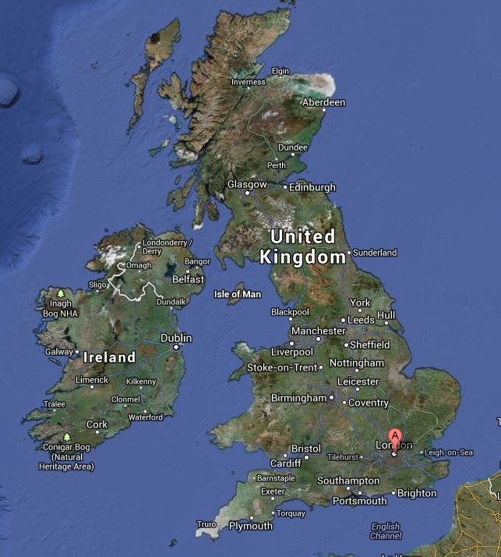
United Kingdom
London, Liverpool and Lincoln
Student Dormitory Housing called Flats
Faculty Led and with FSU

Slide 11
Constructionarium
Bircham Newton, Norfolk England

Slide 12
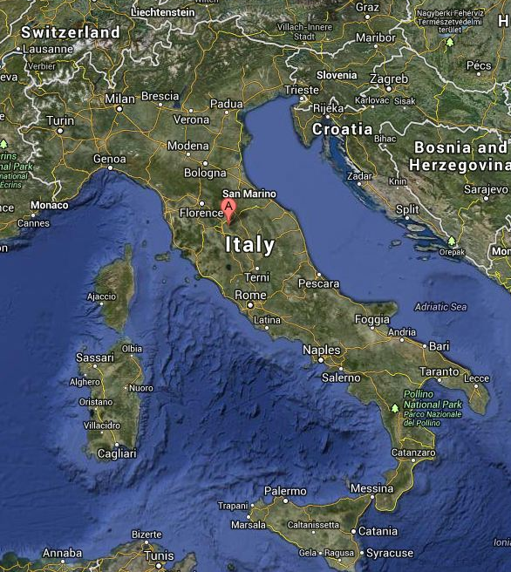
Italy
Castiglion Fiorentino & Florence
Student Dormitory Style Housing
Faculty Led & with FSU

Slide 13
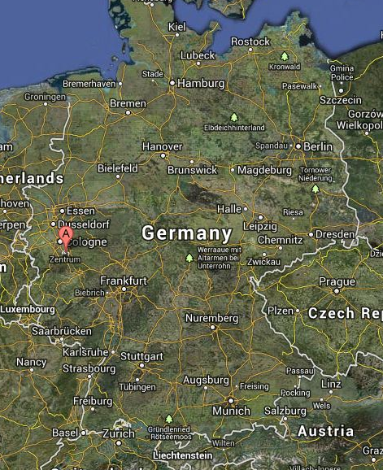
Germany
Bonn, Germany
Host Families with Meals
Faculty Led and German Faculty

Slide 14
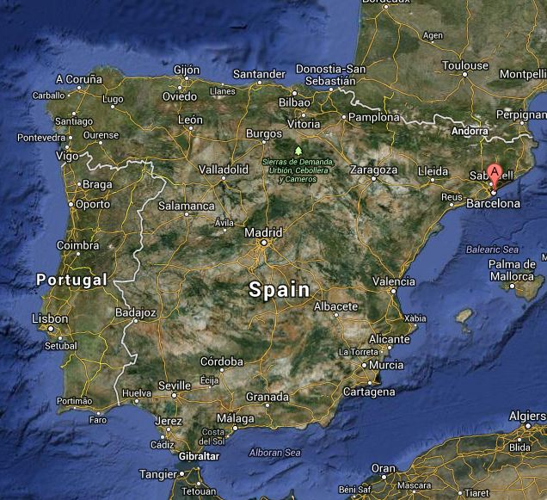
Spain
Barcelona, Spain
BAC - Barcelona Architecture Center
Dormitory Housing

Slide 15
Funding the Program
All existing financial aid can be used toward the
College of Architecture Study Abroad Programs
Scholarships
The Study Abroad Fellowship
The International Education Fee
Global Opportunity Fund
Texas Tomorrow Fund
Student Loans
There is about $1.5 million available in TAMU scholarships just for Education Abroad
https://studyabroad.tamu.edu

Slide 16
Financial Planning
Housing Costs
Dorm release letters are available
Apply for Scholarships
Book travel plans (airfare) in advance; group flights are available upon request.

Slide 17
Positive Impacts of Study Abroad
Study Abroad offers a rich experience professionally and personally.
The students get exposure to unique architecture and are able to participate in global projects.
We find that most of our students return with a renewed passion and more confidence in their studies.

Slide 18
COVID – 19 Updates
COVID and constantly changing travel restrictions, we’ve been advising students to avoid booking travel until told to do so and the program has been confirmed to run.
Airfare booking information will be provided once the program is confirmed
tx.ag/CovidUpdates

Slide 19
Thank you Q&A

